Slide 1
Computer System Overview
Chapter 1

Slide 2
Basic Elements of Computer
Processor
Main Memory
  Volatile(易失的)，referred to as real memory or primary memory
I/O modules
  secondary memory devices(辅助存储设备)
  communications equipment
  Terminals(终端)
System bus
  communication among processors, memory, and I/O modules

Slide 3
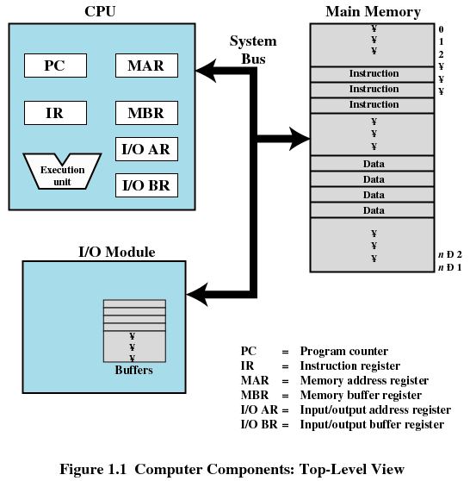
Computer Components: Top-Level View

Slide 4
Processor Registers(寄存器)
Memory address register (MAR)
  Specifies the address for the next read or write
Memory buffer register (MBR)
  Contains data written into memory or receives data read from memory
I/O address register
I/O buffer register

Slide 5
Processor Registers
User-visible registers
  Enable programmer to minimize main-memory references by optimizing register use
Control and status registers
  Used by processor to control operating of the processor
  Used by privileged operating-system routines to control the execution of programs

Slide 6
User-Visible Registers (1)
May be referenced by machine language
Available to all programs - application programs and system programs
Types of registers
  Data
  Address
    Index
    Segment pointer
    Stack pointer

Slide 7
User-Visible Registers (2)
Address Registers
  Index
    Involves adding an index to a base value to get an address
  Segment pointer
    When memory is divided into segments, memory is referenced by a segment and an offset
  Stack pointer
    Points to top of stack

Slide 8
Control and Status Registers (1)
Program Counter (PC, 程序计数器)
  Contains the address of an instruction to be fetched
Instruction Register (IR)
  Contains the instruction most recently fetched
Program Status Word (PSW, 程序状态字)
  Condition codes
  Interrupt enable/disable
  Supervisor/user mode

Slide 9
Control and Status Registers (2)
Condition Codes or Flags
  Bits set by the processor hardware as a result of operations
  Example: arithmetic operation
    Positive result
    Negative result
    Zero
    Overflow

Slide 10
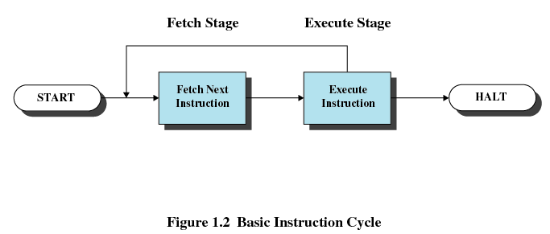
Instruction Execution(指令执行)
Two steps
  Processor reads instructions from memory
  Processor executes each instruction
Instruction cycle(指令周期)

Slide 11
Instruction Fetch and Execute
The processor fetches the instruction (取指令) from memory
Program counter (PC, 程序计数器) holds address of the instruction to be fetched next
Program counter is incremented after each fetch

Slide 12
Instruction Register
Fetched instruction is placed in the instruction register (指令寄存器)
Categories of actions:
  Processor-memory (处理器和内存之间)
    Transfer data between processor and memory
  Processor-I/O (处理器和I/O设备之间)
    Data transferred to or from a peripheral device(外部设备)
  Data processing
    Arithmetic(算术) or logic operation on data
  Control
    Alter sequence (顺序) of execution

Slide 13
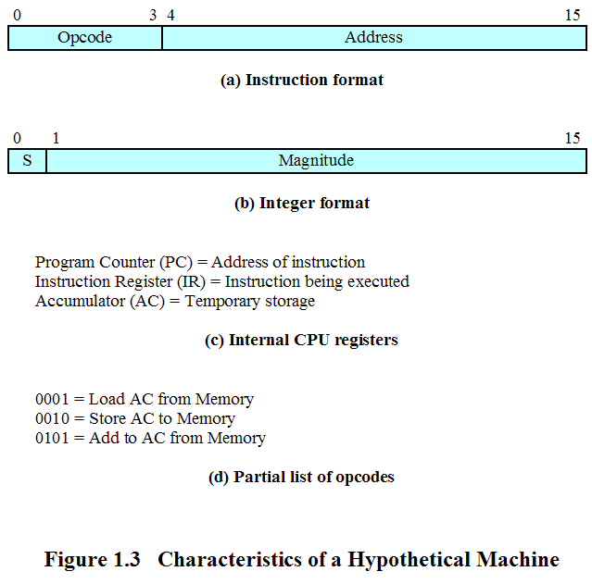
Characteristics of a Hypothetical Machine

Slide 14
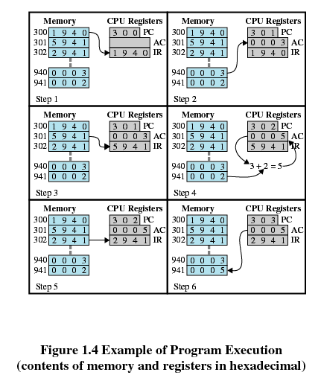
Example of Program Execution

Slide 15
Interrupts (中断)
Most I/O devices are slower than the processor
  Processor must pause to wait for device
Interrupt the normal sequencing of the processor
Interrupts are provided primarily as a way to improve processor utilization

Slide 16
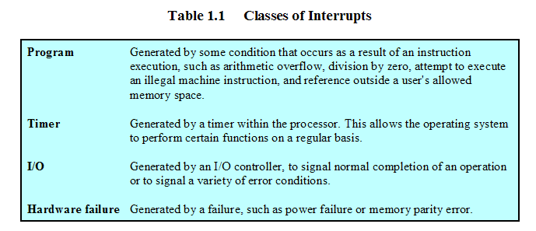
Classes of Interrupts

Slide 17
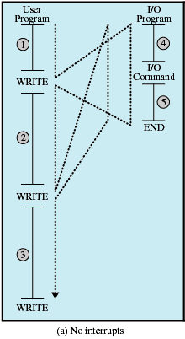
Program Flow of Control Without Interrupts

Slide 18
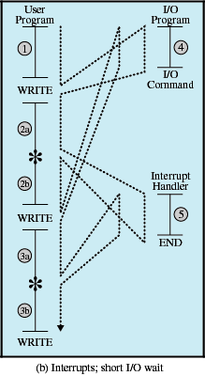
Program Flow of Control With Interrupts, Short I/O Wait

Slide 19
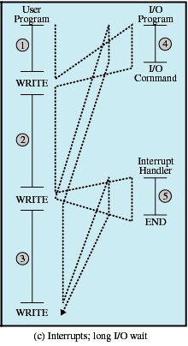
Program Flow of Control With Interrupts, Long I/O Wait

Slide 20
Interrupt Handler(中断服务程序)
Program to service a particular I/O device
Generally part of the operating system
Interrupt Service Routine(ISR, 中断服务程序)

Slide 21
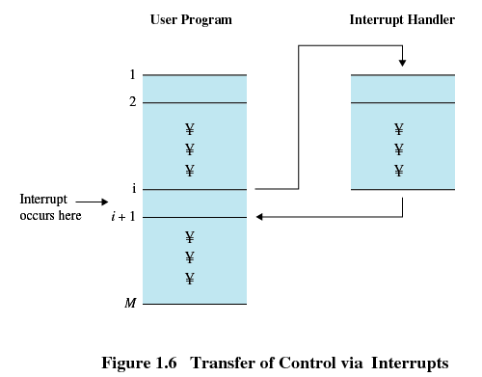
Interrupts
Suspends (挂起) the normal sequence of execution

Slide 22
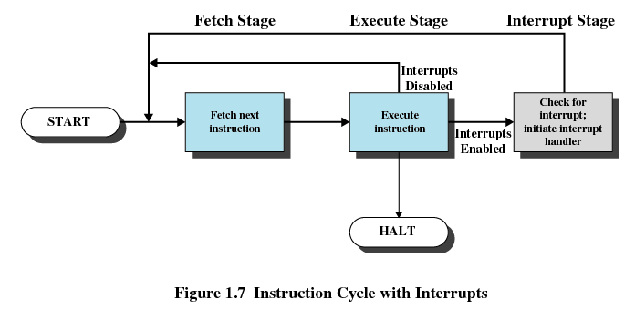
Interrupt Cycle

Slide 23
Interrupt Cycle
Processor checks for interrupts
If no interrupts fetch the next instruction for the current program
If an interrupt is pending, suspend execution of the current program, and execute the interrupt-handler routine

Slide 24
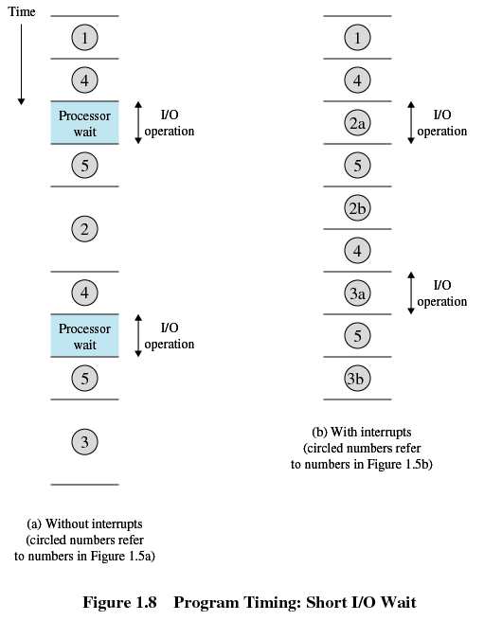
Timing Diagram Based on Short I/O Wait

Slide 25
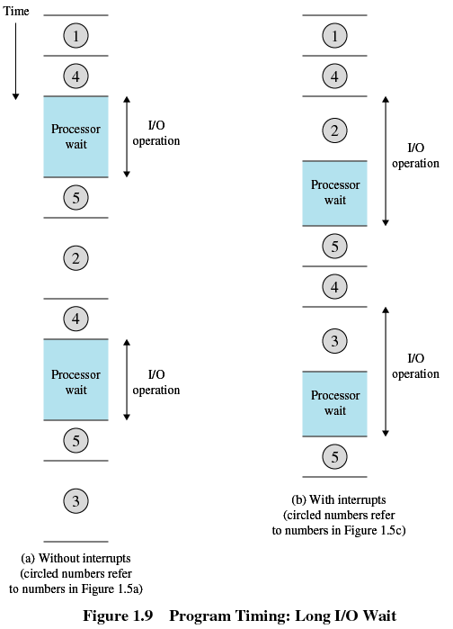
Timing Diagram Based on Short I/O Wait

Slide 26
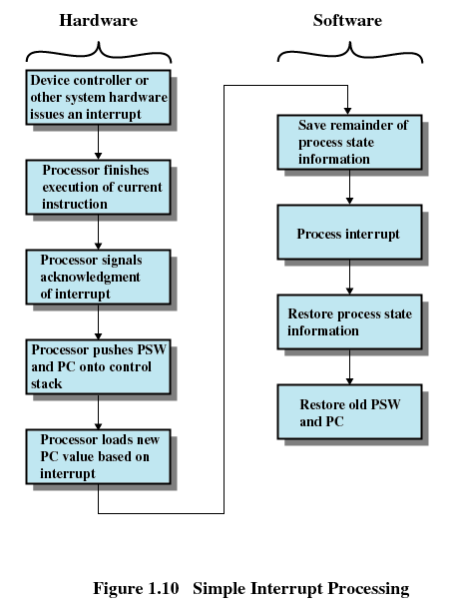
Simple Interrupt Processing

Slide 27
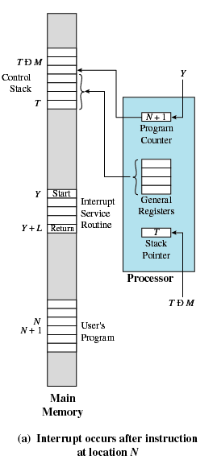
Changes in Memory and Registers for an Interrupt

Slide 28
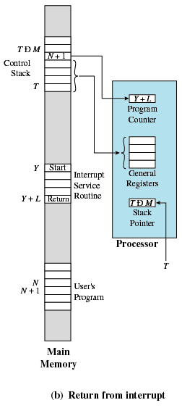
Changes in Memory and Registers for an Interrupt

Slide 29
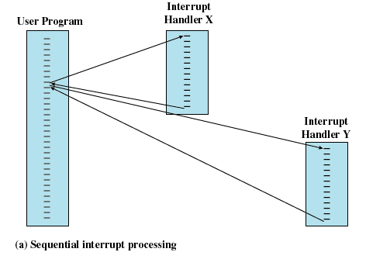
Multiple Interrupts
Disable interrupts while an interrupt is being processed

Slide 30
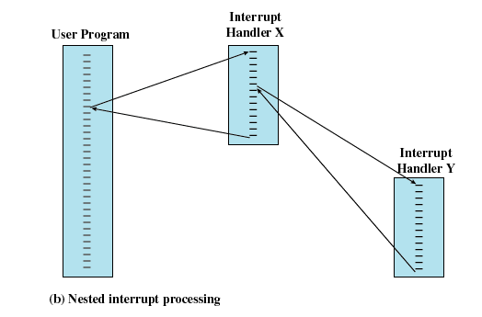
Multiple Interrupts
Define priorities (优先级) for interrupts

Slide 31
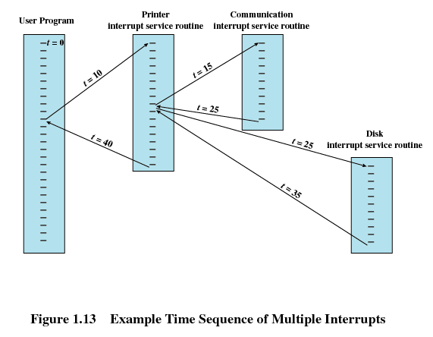
Multiple Interrupts

Slide 32
Multiprogramming (多道)
Processor has more than one program to execute
The sequence the programs are executed depend on their relative priority and whether they are waiting for I/O
After an interrupt handler completes, control may not return to the program that was executing at the time of the interrupt

Slide 33
Memory Hierarchy (存储层次)
Faster access time, greater cost per bit
Greater capacity, smaller cost per bit
Greater capacity, slower access speed

Slide 34
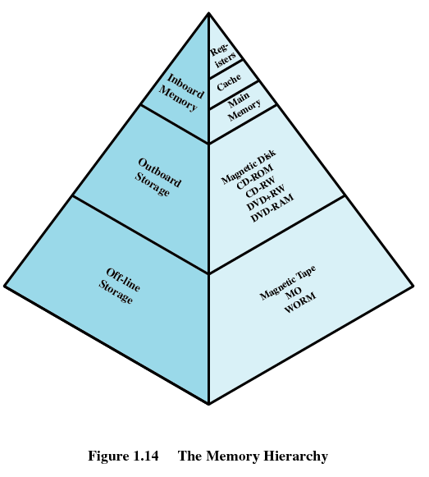
Memory Hierarchy

Slide 35
Going Down the Hierarchy
Decreasing cost per bit
Increasing capacity
Increasing access time
Decreasing frequency of access of the memory by the processor
  Locality of reference

Slide 36
Secondary Memory (辅助存储器)
Used to store program and data files
Nonvolatile (非易失的)
Auxiliary memory (辅助存储)

Slide 37
Disk Cache (磁盘高速缓存)
A portion of main memory used as a buffer to temporarily to hold data for the disk
Disk writes are clustered
  Some data written out may be referenced again. The data are retrieved rapidly from the software cache instead of slowly from disk

Slide 38
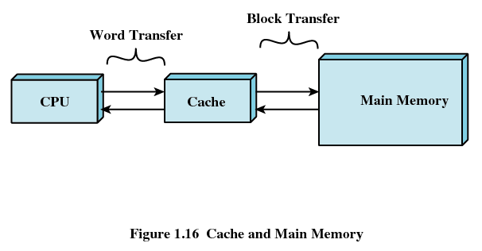
Cache Memory (高速缓存)
Invisible to operating system
Increase the speed of memory
Processor speed is faster than memory speed
Exploit the principle of locality

Slide 39
Cache Memory
Contains a copy of a portion of main memory
Processor first checks cache
If not found in cache, the block of memory containing the needed information is moved to the cache and delivered to the processor

Slide 40
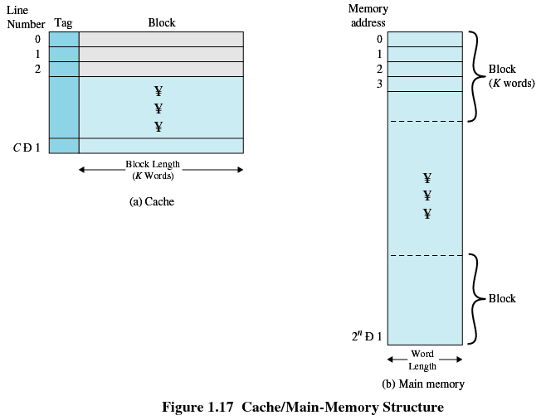
Cache/Main Memory System

Slide 41
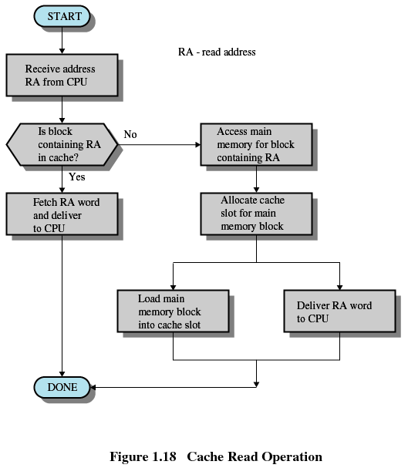
Cache Read Operation

Slide 42
Cache Design
Cache size
  Small caches have a significant impact on performance
Block size
  The unit of data exchanged between cache and main memory
  Larger block size more hits until probability of using newly fetched data becomes less than the probability of reusing data that have to be moved out of cache

Slide 43
Cache Design
Mapping function
  Determines which cache location the block will occupy
Replacement algorithm
  Determines which block to replace
  Least-Recently-Used (LRU) algorithm

Slide 44
Cache Design
Write policy
  When the memory write operation takes place
  Can occur every time block is updated
  Can occur only when block is replaced
    Minimizes memory write operations
    Leaves main memory in an obsolete state

Slide 45
I/O Communication Techniques
Three techniques are possible for I/O operations:
  Programmed I/O
  Interrupt-driven I/O
  Direct memory access (DMA)

Slide 46
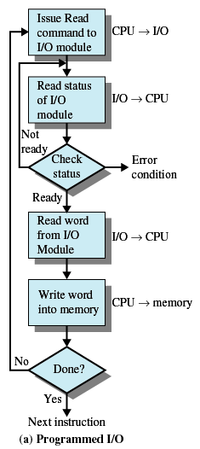
Programmed I/O
I/O module performs the action, not the processor
Sets appropriate bits in the I/O status register
No interrupts occur
Processor checks status until operation is complete

Slide 47
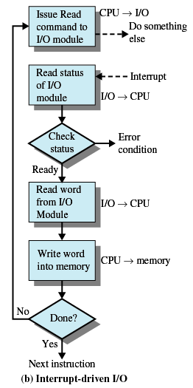
Interrupt-Driven I/O
Processor is interrupted when I/O module ready to exchange data
Processor saves context of program executing and begins executing interrupt-handler
No needless waiting
Consumes a lot of processor time because every word read or written passes through the processor

Slide 48
Direct Memory Access (DMA)
I/O exchanges occur directly with memory
Processor grants I/O module authority to read from or write to memory
Relieves the processor responsibility for the exchange

Slide 49
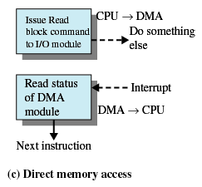
Direct Memory Access
Transfers a block of data directly to or from memory
An interrupt is sent when the transfer is complete
Processor continues with other work

